Slide 1
ITRAF Lecture Series
27th May 2022
Tax Consolidation
P V Srinivasan

Slide 2
Tax Levy
Taxable Unit
Tax Base
Tax Rate

Slide 3
Tax Consolidation - Concept
Entire Group is one Economic Unit. Hence, the Group should be taxed on its overall profits rather than taxing each constituent entity.
Tax consolidation, or combined reporting, is a regime which treats a group of wholly owned or majority-owned companies and other entities (such as trusts and partnerships) as a single entity for tax purposes.
Group taxation is designed to reduce the effect that the separate existence of related companies has on the aggregate tax liability of the group.
To achieve Tax Neutrality – Say differences in tax treatment of two divisions carrying separate business of one entity and two separate entities belonging to same group.
  But is it all the same – whether you do separate businesses in different divisions or different entities? – May be not since each separate legal entity has limited liability for which only it is liable and not for the liabilities/assets of other group companies.
Generally, consolidation is an irrevocable decision.
Head entity of the group is responsible for all tax obligations.

Slide 4
Tax Policy Attributes
Simplicity
  Economy in cost of collection
  Convenience of payment
  Predictability
  Scalability
  Confidentiality
Tax Revenue / Anti Avoidance
  Minimum tax gap
  Revenue impact (Intra-group loss offset?)
  Exchange of information
  Self regulation
Fairness
  Certainty
  Equity
  Transparency
Neutrality
Economic growth and efficiency
Globally harmonised
Tax administration maturity

Slide 5
Tax Consolidation Overview
Ownership Criteria
Intra-group loss set-off
  Pre-consolidation loss
  Loss during consolidation term
  On exit
  On Deconsolidation
Intra-group asset transfer
  Deferred gain / loss
  Recognised gain / loss
Intra-group shareholding
Loss - double dip prevention
Tax Treaty
Domestic anti-avoidance provisions
  Transfer pricing
  CFC regulation
  Interest deduction
Treaty application

Slide 6
Eligible Entities - Mandatory V/s Elective Application
Common Control is essential for a “Group”.
  Criteria could be – Minimum % voting rights, control through quasi equity instruments, control over composition of BOD, special shareholders’ agreements.
Continuous loss-making companies, Tax-exempt companies and Companies with differential tax rates are not included.
Companies in bankruptcy and litigation are also ignored.
Jurisdictional limitation – Country, Region, Worldwide.

Slide 7
Consolidated / Fiscal Group - Scope
Worldwide Group
Trade Bloc Group
Country Group
S7 Ltd
Subsidiary
S8 Ltd
S6 Ltd
Subsidiary
Subsidiary
S4 Ltd
Subsidiary
S3 Ltd
S5 Ltd
Subsidiary
Subsidiary
S1 Ltd
S2 Ltd
PE of H Ltd
Subsidiary
Subsidiary
H Ltd

Slide 8
Tax Consolidation Mechanics
Pooling Concept
  Each constituent entity remains separate.
  Deduction/exemptions/benefits are individually computed.
  Tax consolidation is achieved at the Group level.
Attribution or Absorption Concept
  Subsidiaries deemed to have become divisions of the parent / head entity
  Individual legal existence is deemed to have ceased for tax purposes.
  Assets /Liabilities attributed to Group.
  Incomes and expenditures are deemed to be of Group.
Contribution Concept
  Each entity after the tax base is computed may decide contribute whole or part of the losses to the Parent or other Group entities.

Slide 9
Methods of Consolidation / Scope of the Group
Tax Consolidation
Pooling
Absorption
Attribution
Worldwide Group
Country Group
Trade Bloc Group

Slide 10
Tax Consolidation – Different Forms
United States - Consolidated Returns & Unitary Filing
  Consolidation by election by companies connected through stock ownership.
  Different levels of consolidation and combination at State levels.
Netherlands - Fiscal Unity
    All group entities are treated as one single entity.
    Profits/Losses of group entities are combined for consolidated tax treatment.
    All benefits, set offs, deductions etc. are granted at group level.
Group Relief – UK
  Loss transfer system which preserves separate identities of the member entities.
  Such loss-making entity decides whether it would like to transfer part or whole of its losses to other profit-making entities of the group.

Slide 11
Affiliated group in USA
Part C
Part A
Part B
P Corp
Common US Parent
P Corp
Common US Parent
P Corp
Common US Parent
80%
Sub Corp 1
80%
80%
80%
80%
80%
Sub Corp 1
US
Sub Corp 2
US
Sub Corp 1
US
Sub Corp 2
US
Sub Corp 2
80%
40%
40%
Sub Corp 3
Sub Corp 3
US
80%
Sub Corp 4

Slide 12
Intermediary company in foreign jurisdiction?
Part B
Part A
P Corp
Common US Parent
P Corp
Common US Parent
100%
100%
Foreign Corp
Foreign Corp
70%
Sub Corp 1
US
Sub Corp 1
US
30%
100%

Slide 13
Avoidance through double dip in the US
Country X
US
Profit – US $ 200
Loss – US $ 100
P Corp
Common US Parent
US Check the Box
Sub Corp 2
Loss– US $ 100
Profit – US $ 100
100%
100%
Sub Corp 1
Sub Corp 3
Profit of P Corp | 200
Loss of Sub Corp 2 [Check the box] | (100)
Sub-total | 100
Loss of Sub-Corp 1 | (100)
US Consolidated Taxable Income | Nil
Loss of Sub-Corp 2 | (100)
Profit of Sub-Corp 3 | 100
Country X - Consolidated Taxable Income | Nil

Slide 14
PE of a foreign subsidiary
UK
Overseas
P Co, UK
100%
100%
Non Resident Foreign Corp
Sub Co 1
UK
UK PE
100%
Sub Co 2
UK

Slide 15
Horizontal Group in France
EU Parent Company
EU / EEA
France
95%
95%
95%
Sub 1 - France
Sub 2 - France
Sub 3 - France

Slide 16
Horizontal Group of PEs in Italy
EU Parent Company
100%
100%
100%
EU Sub Co 1
EU Sub Co 2
EU Sub Co 3
EU / EEA
Italy
PE 1 - Italy
PE 2 -Italy
PE 3 - Italy

Slide 17
Treatment of tax attributes - Losses
Losses:
Pre-Consolidation Losses:
  Quarantine – Losses of subsidiary pre--‐consolidation and the same will remain with the subsidiary and will be offset against its future taxable income (SRLY in the US).
  Transfer without any limitation and any pre-condition to the parent/group
  Cancellation/Lapse: Pre--consolidation losses are cancelled upon entry into a consolidated group.
Losses on exit:
  Stay with the Group – On exit of subsidiary the losses stay with the group though the subsidiary may have contributed to such losses. Similar to Sec 355 spin-off transactions in the US.
  Apportionment – Group losses are apportioned to a leaving subsidiary based on apportionment rules. For e.g., Germany.

Slide 18
Treatment of tax attributes - Assets
Transfer of Assets:
On Entry – 2 options
  Roll Over Treatment – Assumed to be transferred “At Cost” basis, or
  Mark to Market – Assumed to be transferred “At Market Value” basis
During Consolidation
  Treated as if transactions within different divisions of a single entity and has no impact of tax – whether deferred or current.
  Another approach, “Deferred Gain/Loss Approach” where the gain/loss on intra group transfer of assets are recognized when the transferor or transferee leaves the group – similar to Sec 47A provisions.
On Exit
  Mostly it is governed in same manner as during consolidation and deferred until assets are sold or subsidiary leaves the controlled group.
  In case of “Roll Over Treatment” – Assets are transferred “At Cost” on exit.
  Normally no Immediate taxation arises on exit.

Slide 19
Tax Consolidation – Benefits and Limitations
Benefits:
Set-off of losses and profits within the group.
Elimination of tax on intra-group transfers of assets.
Better cash management as inter-company dividends between group members are eliminated from Income.
Deductions and credits which are subject to conditions of percentages/size etc. can be easily met on consolidated basis rather than at entity levels.
Serves as an effective anti-abuse in the home country of Parent entity.
Limitations:
Additional compliance costs and administrative burdens.
Election for Group Taxation can be binding for future years and group may not be able to roll back such decision in future.
Deduction and Credits of entities may be curtailed because of huge losses of other group entities
Time limitation on carry forward of losses or for incentives: Change of entity level tax Year to meet Group Tax Year, curtailing changeover year to less than 12 months and thus such lapse of year.
Lack of robust foreign tax credit provisions may hamper consolidation and may add to effective tax rate (ETR).

Slide 20
Consolidated Tax Returns - US
Consolidation of entities inter-connected by stock ownership of 80% of more.
Common parent essential. Brother-sister consolidation not permissible.
  Exempt entities, insurance companies (tax planning to create captive insurance companies), REIT, S Corp not eligible.
  Foreign corporations - May elect to treat 100% owned Canadian or Mexican corp as domestic.
Elimination of inter-company transaction including dividends, transfer of assets, transaction of sale, services,
De-consolidation of group – 5 year restriction applicable for re-consolidation.
Accounting period – Parent, Accounting method – individual company.
Allocation of NOL to each company before and after set-off. Elaborate rules for allocation. Rules to adjust capital/carry over base for set-off losses contributed by subsidiary.
Deduction and incentives like R&D, Domestic Production Activities Deduction, interest disallowance etc. are computed at group level and allocated to each entity.
States – have varying methods – some adopt Unitary Combined, some mandatory combined, some include PE of foreign companies as well.

Slide 21
Group Relief - UK Model
In principle, there are no consolidation rules in UK.
However, there are specific provisions that recognize the economic unity of interest between group companies by allowing for
  the elimination of gain and loss recognition on intragroup transactions involving capital assets (tax neutral transfers of capital assets),
  the surrender of non-capital losses of one group member to a related group member (group relief surrender of losses).
Surrender of losses has been extended to foreign subsidiaries through Marks and Spencer Ruling in 2005 later incorporated into UK Domestic Law with checks and balance.

Slide 23
Group Taxation - EU
First tabled in 2011, the Common Consolidated Corporate Tax Base (CCCTB) was designed to strengthen the Single Market for businesses. While Member States made considerable progress on many core elements but they were unable to reach a final agreement.
During Oct 2016, EU commission re-launched CCCTB to make corporate taxation in the EU fairer, more competitive and growth-friendly. New features:
  The original CCCTB proposal was optional for all companies. But re-launched CCCTB will be mandatory for large groups.
  Plugs loopholes associated with profit-shifting for tax purposes.
  Encourage companies to finance their activities through equity and by tapping into markets rather than turning to debt.
  Support innovation through tax incentives for Research and Development (R&D) activities linked to real economic activity.
  Company's taxable profits will be shared between Member States in which the company is active using an apportionment formula based on assets, labour and sales with equal weightage. Each Member State can then tax their share of the company's profits at their own national rate.

Slide 24
Group Taxation - EU
Objectives
  Harmonization of Tax Base.
  Full Consolidation of Group Profits across EU.
  Tax Rates at discretion of members.
Eligibility Criteria
  Immediate or Lower Tier Subsidiaries with certain threshold of Control and Ownership. Also PE may be part of CCCTB.
  More than 50% Voting Power and 75% of Capital or Profit Share.
  Territorial Scope – Limited to EU, however outside EU Companies may still qualify if their subsidiaries/PE located in EU.
  Once option exercised for Group Taxation, all sub/PE will be covered.
Apportionment of Consolidated Tax Base
  Each member has separate tax rates hence CCCTB directive does apportionment of Group Tax Base based on formula.
  Formula is based on three factors – Sales, Labour and Assets
  Share of Country A = [1/3 Sales A / Group Sales + 1/3{1/2 Payroll of A / Group Payroll+1/2 No. of Emp of A / Group Emp} + 1/3 Assets of A / Group Assets] * Consolidated Tax Base.
Term
  If opted for CCCTB rules, it is binding for 5 years and thereafter prolonged for another 3 years unless timely notice of termination is given.

Slide 25
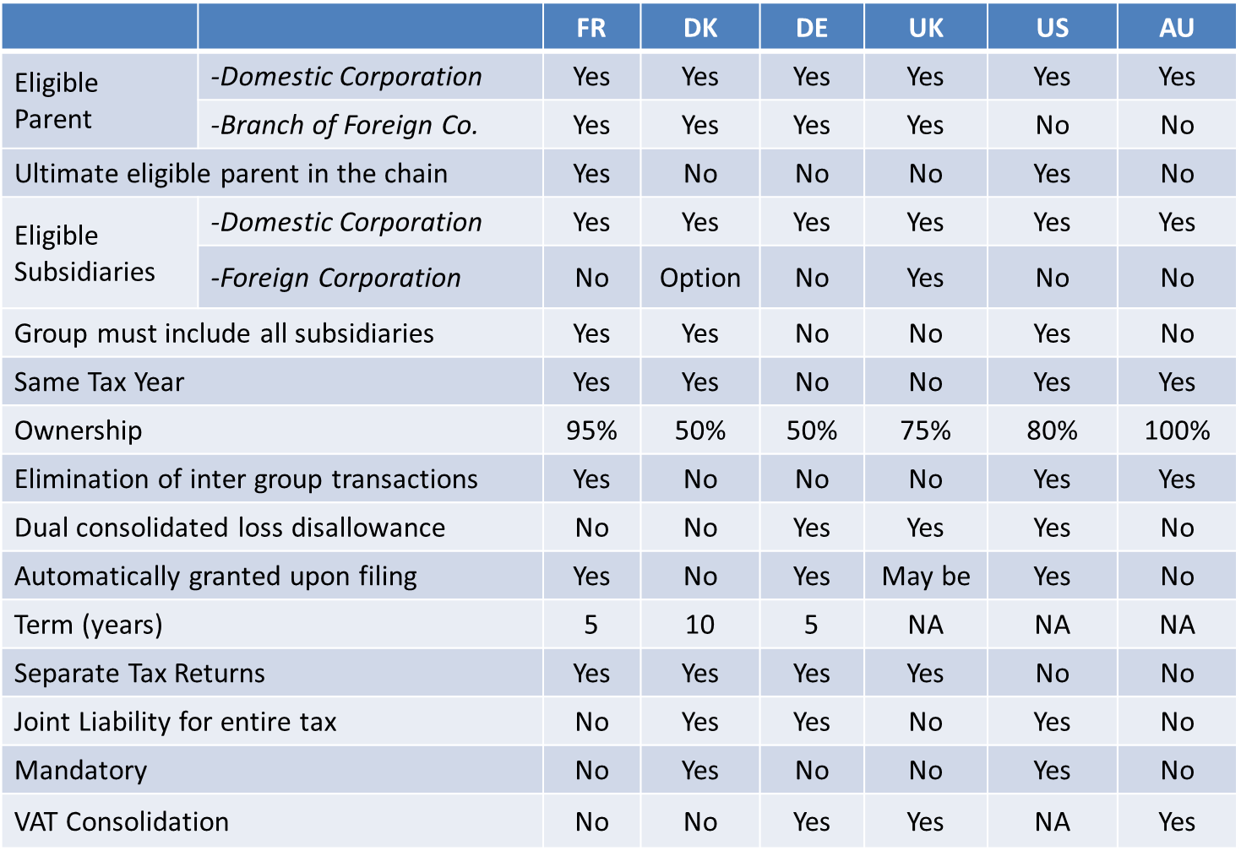
Tax Consolidation - Comparison

Slide 26
Indian Scenario
No Group Taxation in India.
No taxation for transfer of Capital Assets between H Co and wholly owned S Co., transferee being an Indian Company.
Applicability of Transfer Pricing Regulations in case of Associated Enterprises under common control, capital or management.
Concept of PoEM introduced in 2015. POEM is counter intuitive to Group Taxation. Combination of consolidated return and CFC regulations can effectively replace PoEM.
Options of Amalgamation, Mergers, Demergers etc. for set off of losses or tax planning purposes within group entities.

Slide 27
Global Tax Developments – Minimum Tax
Global Anti-Base Erosion (GLoBE) Rules intended to ensure payment of minimum level of MNE groups in each of the operating jurisdictions.
Reckons the Consolidated Financial Statements for Revenue threshold of Euro 750 Mn.
Group means:
one that includes at least one Entity or PE that is not located in the jurisdiction of the Ultimate Parent Entity.
a collection of Entities that are related through ownership or control such that the assets, liabilities, income, expenses and cash flows of those Entities:
  are included in the Consolidated Financial Statements of the Ultimate Parent Entity; or
  are excluded from the Consolidated Financial Statements of the Ultimate Parent Entity solely on size or materiality grounds, or on the grounds that the Entity is held for sale.
An Entity that is located in one jurisdiction and has one or more PE located in other jurisdictions provided that the Entity is not a part of another Group described in ‘b’ above.

Slide 28
BEPS MLI – Articles
Article | Particulars
14 | Splitting up of contracts : Address avoidance of PE by splitting up contracts between related enterprises to circumvent the threshold of PE creation. India is silent on this position. To apply to all its CTAs.
15 | Definition of “person closely related to an enterprise”. Defines in the context of Article 12, 13, 14 of the MLI. India is silent on this position. To apply to all its CTAs.
28

